Slide 1
Exploratory Data Analysis and Credit Assessment in Financial Services

Slide 2
This case study focuses on analyzing customer data from L&T Financial Services to assess creditworthiness and improve loan disbursal strategies. The primary goals are to perform data preprocessing, exploratory and descriptive analysis, build predictive models, and provide actionable insights to reduce Non-Performing Assets (NPAs) and enhance profitability.
Understanding the financial services domain is crucial. Key aspects include:
Asset and Liability Management: Managing investments and obligations over time, considering risks.
Credit Assessment: Evaluating a customer's ability to repay loans to minimize risks like NPAs.
Customer Profiling: Analyzing demographics, credit history, income, etc., to make informed lending decisions.

Slide 3
Detailed Breakdown of Objectives
a. Data Assessment and Preprocessing
Evaluate Available Data: Understand the dataset's structure, types of variables, and relevance.
Handle Missing Values: Identify and address gaps in the data using imputation or removal techniques.
Encode Categorical Variables: Convert non-numeric categories into numerical formats using techniques like One-Hot Encoding or Label Encoding.
Feature Engineering: Create new features that might better capture the underlying patterns (e.g., debt-to-income ratio).
b. Exploratory Data Analysis (EDA)
Identify Patterns and Trends: Look for recurring themes or behaviors in the data.
Analyze Relationships: Examine how different variables interact, such as income vs. loan default rates.
Key Factors to Explore: CIBIL score, payment history, credit history, geographical location, profession, income, age, education.
c. Descriptive Analysis
Descriptive Statistics: Calculate measures like mean, median, mode, standard deviation.
Visualizations: Create charts (histograms, bar charts, scatter plots) to represent data visually.
Statistical Tests: Perform tests (e.g., Chi-square, t-tests) to determine significant differences or associations.

Slide 4
d. Credit Risk Assessment
Evaluate Creditworthiness: Use demographic information, credit scores, payment and credit history to assess the likelihood of loan repayment.
Risk Factors: Identify which factors most significantly impact credit risk.
e. Predictive Modeling
Build Models: Develop machine learning models to predict loan defaults.
Algorithms to Consider: Logistic Regression, Decision Trees, Random Forests, Gradient Boosting.
Feature Selection: Choose relevant features that contribute most to the prediction.
f. Evaluation and Recommendations
Assess Model Performance: Use metrics like Accuracy, Precision, Recall, F1-Score, ROC-AUC.
Insights on Credit Risk: Highlight key factors influencing creditworthiness.
Recommendations: Suggest strategies to improve credit assessment and loan disbursal, such as refining the scoring model or targeting specific customer segments.

Slide 5
Approaching Each Checkpoint
Checkpoint 1: Data Manipulation and EDA
Data Manipulation and Visualization using Python
Tools: Python libraries like Pandas, NumPy, Matplotlib, Seaborn.
Tasks:
Load and clean the dataset.
Handle missing values and encode categorical variables.
Perform feature engineering.
Create initial visualizations to understand data distributions and relationships.
Statistical Analysis and EDA
Tasks:
Conduct detailed EDA to uncover patterns and insights.
Perform statistical tests to validate findings.
Document key observations that will inform further analysis and modeling.

Slide 6
We are give 8 datasets
City_Master
Loan_Details_Transaction
Brach_Id_master
State_Region_mapping
Loan_Status_mapping
Region_master
Postal_code_master
State_master

Slide 7
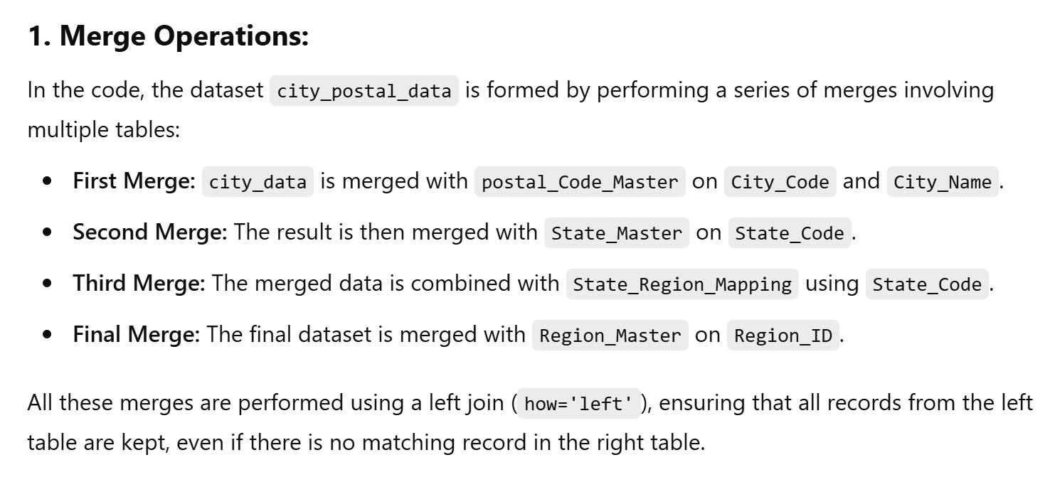
DATA ANALYSIS-
DATA EXPLORATION-
Data analysis for the city level data

Slide 8
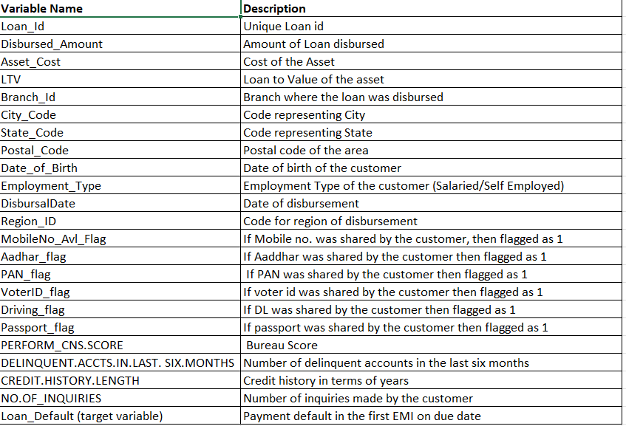
Total of 23 columns Total data 23315 rows × 23 columns

Slide 9
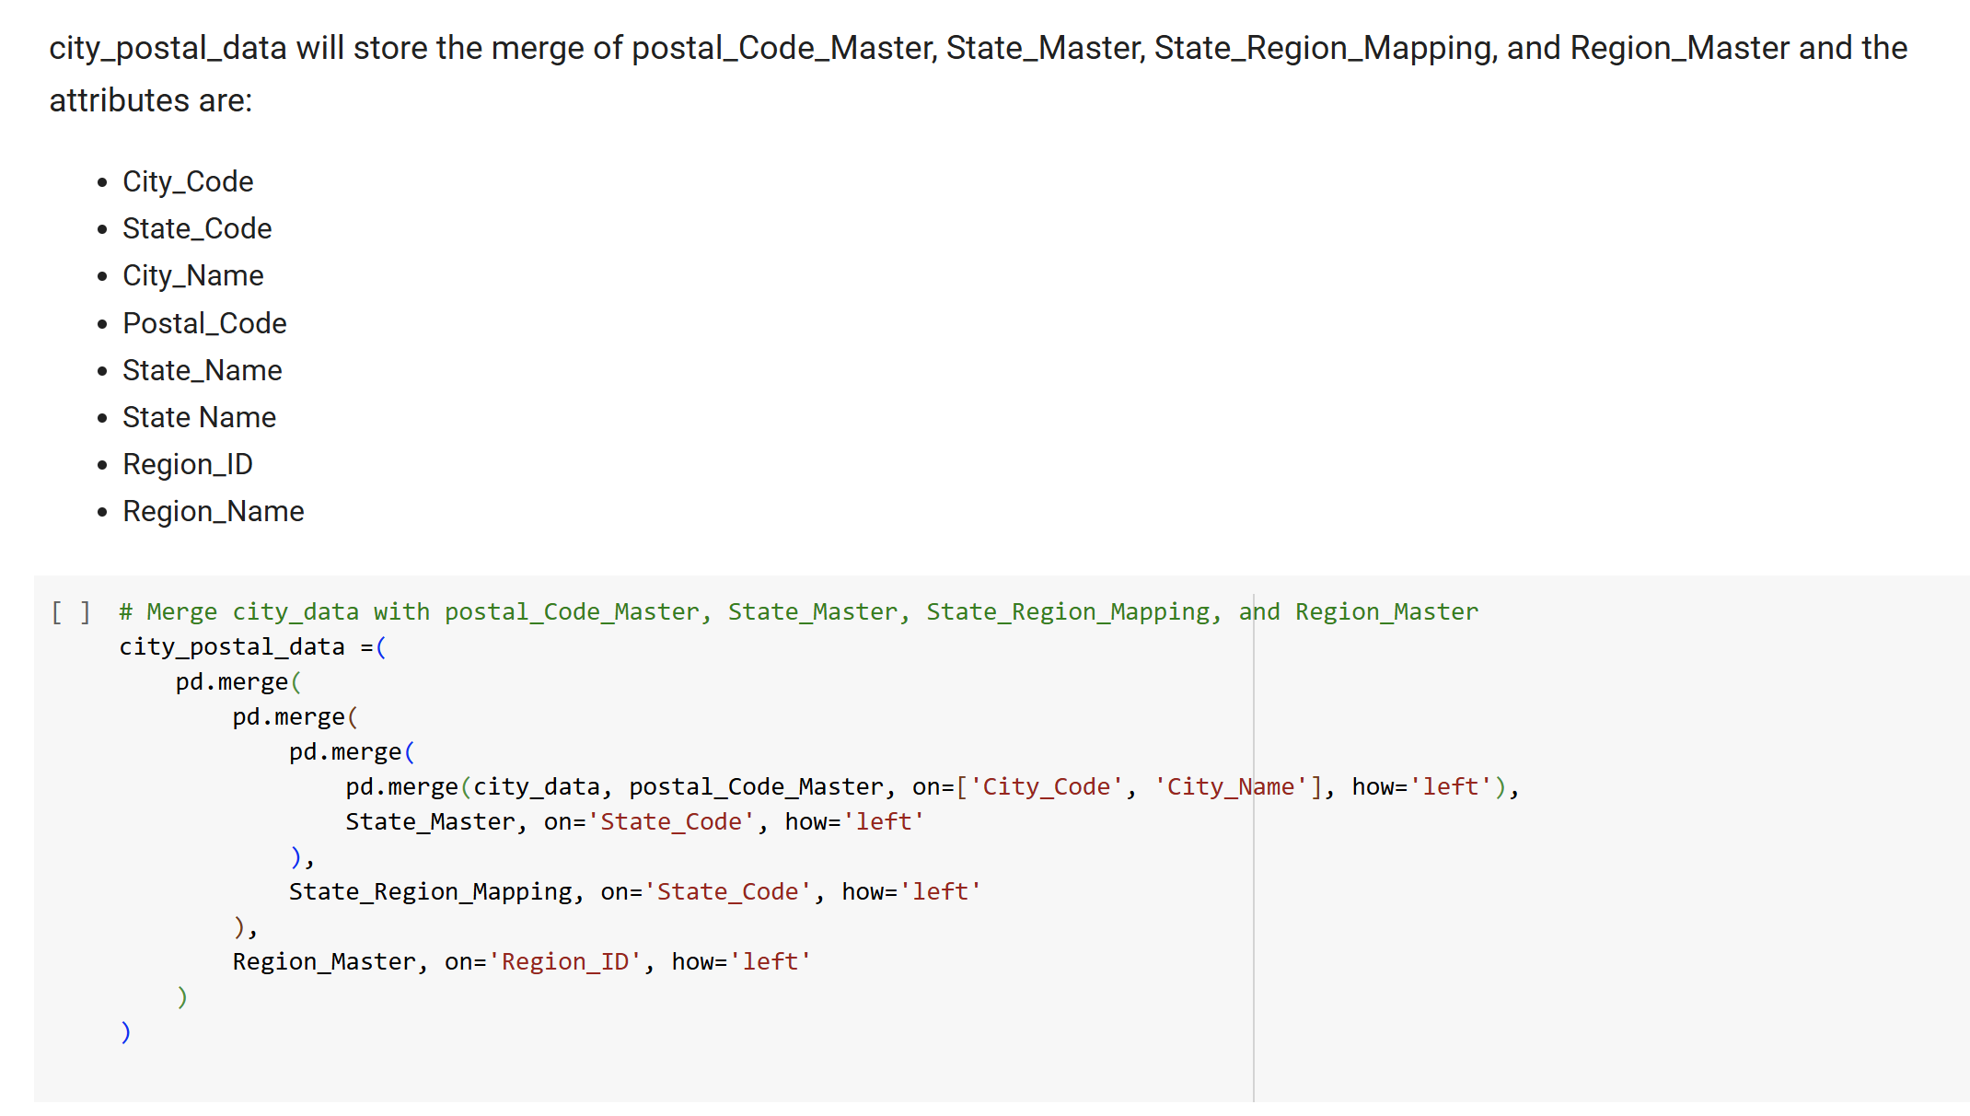

Slide 10
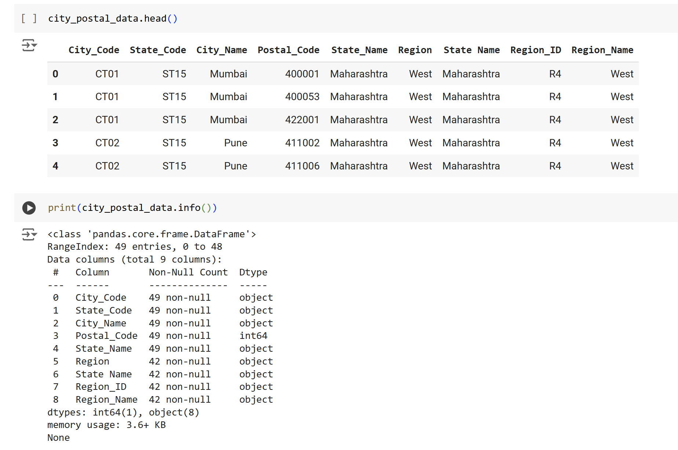

Slide 11
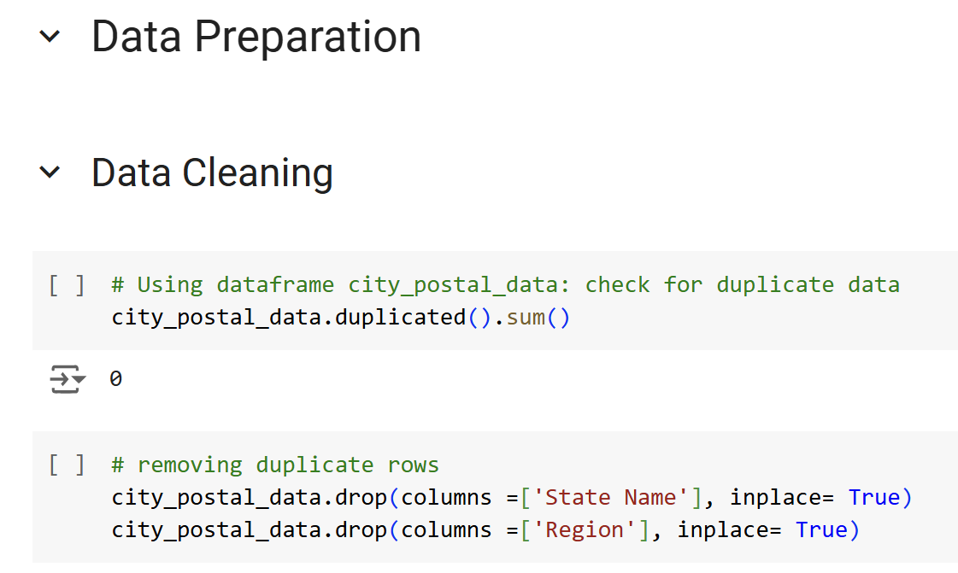
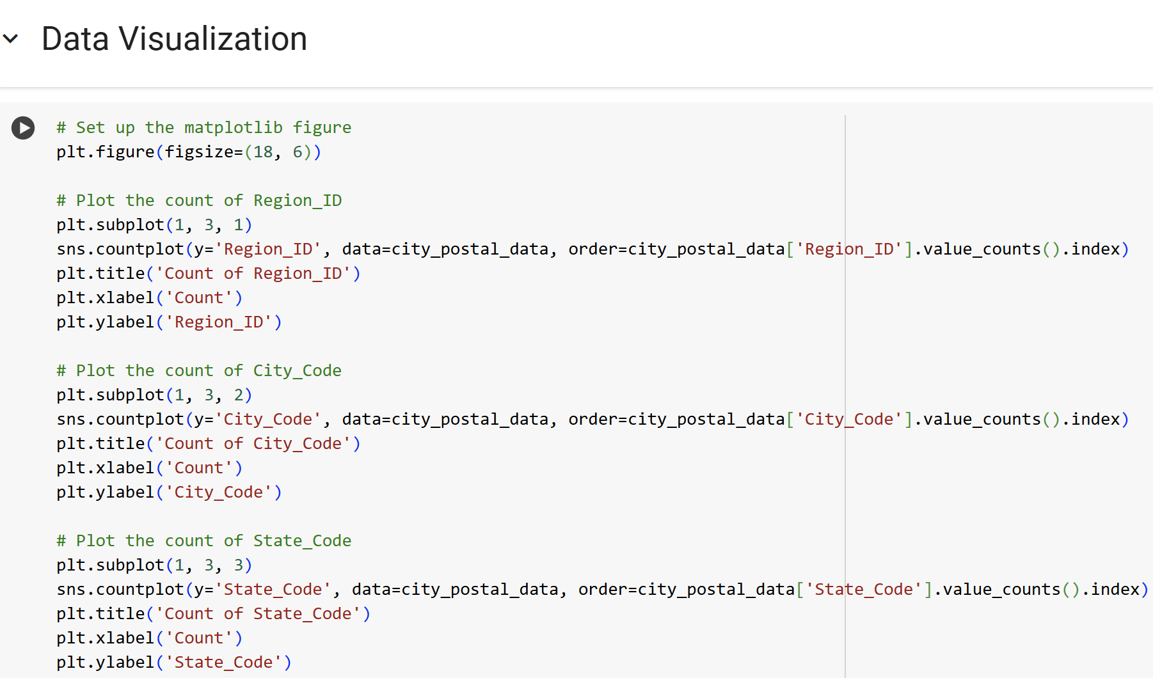

Slide 12
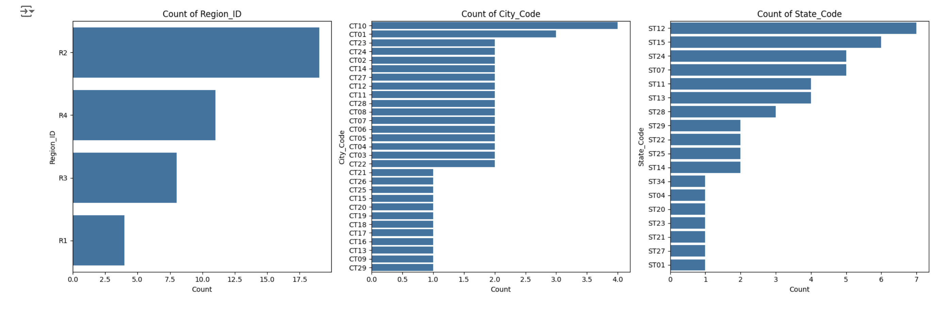

Slide 13
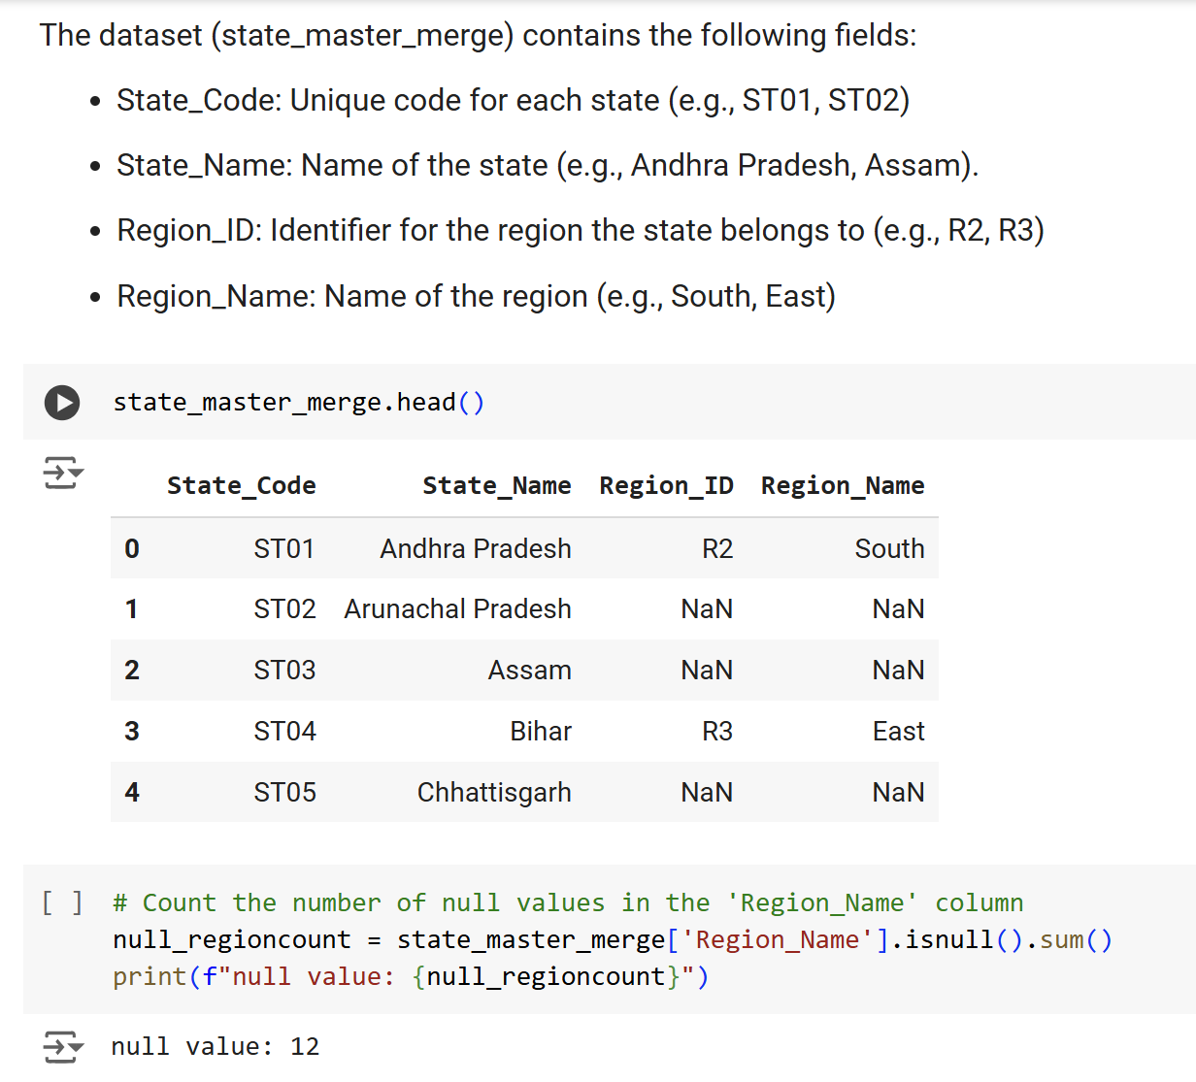
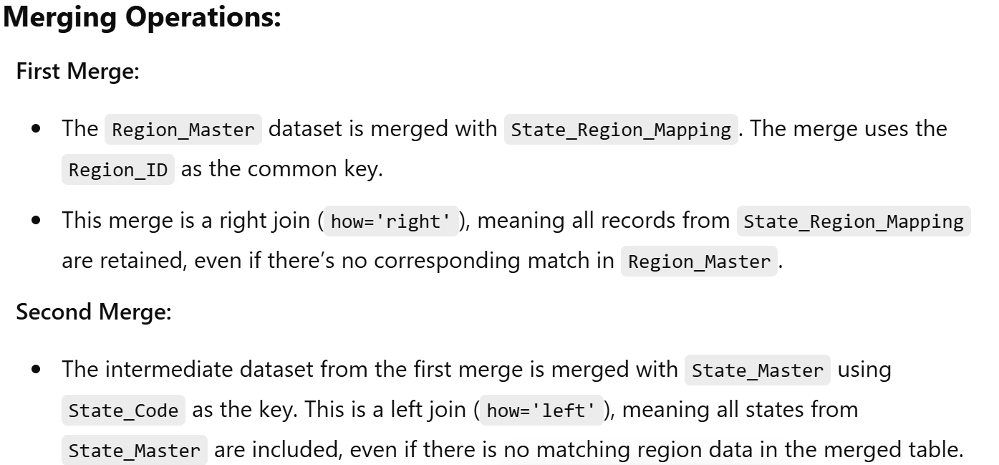
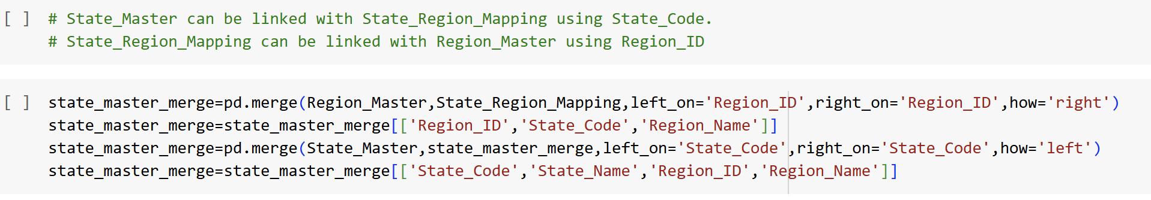
Analysis of the State and Region Level Data Merge

Slide 14
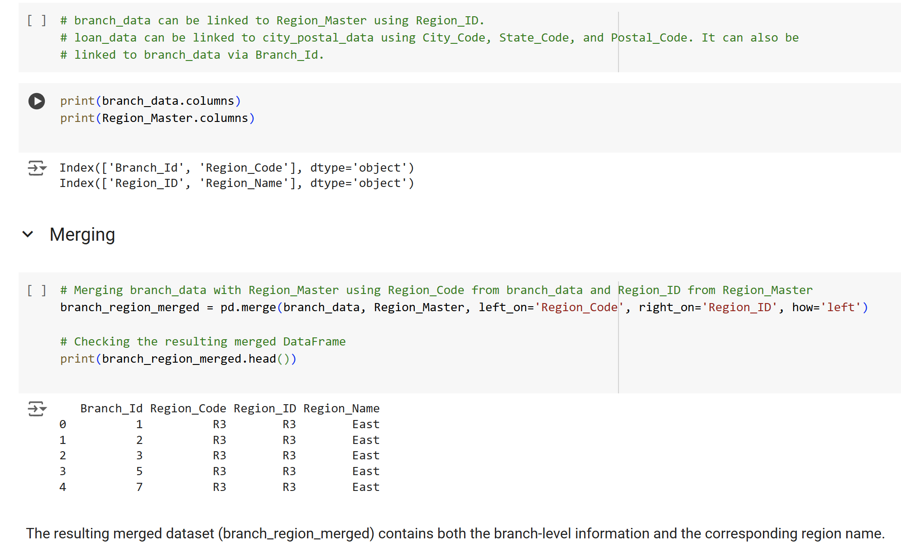
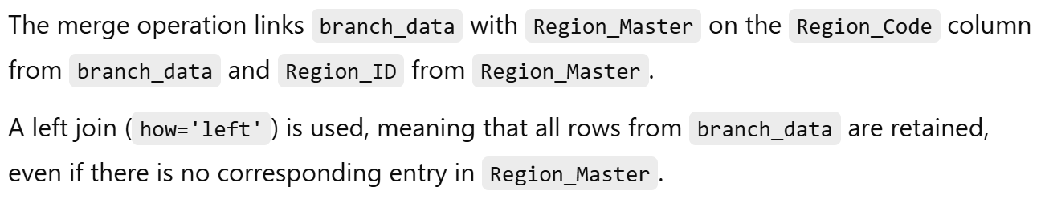
Analysis of Branch Level Data Merge:

Slide 15
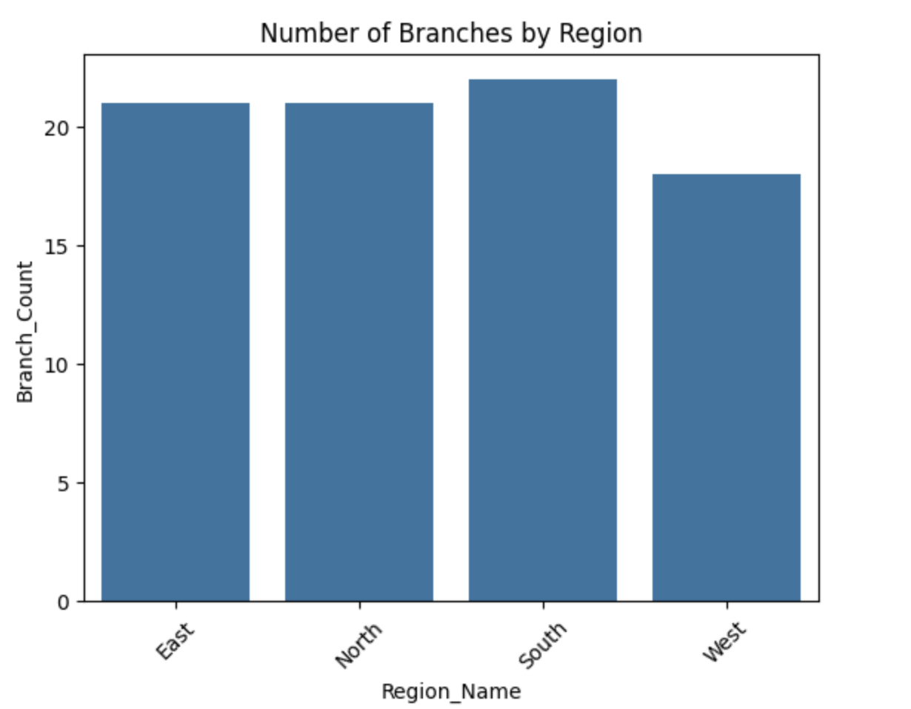
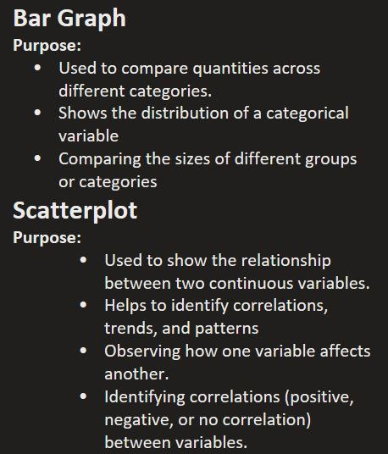
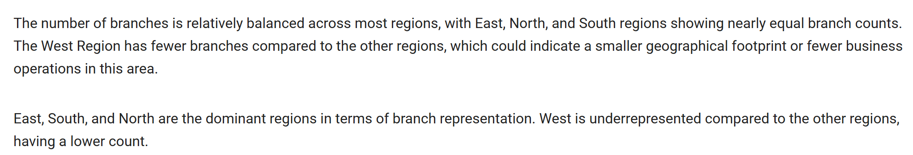

Slide 16
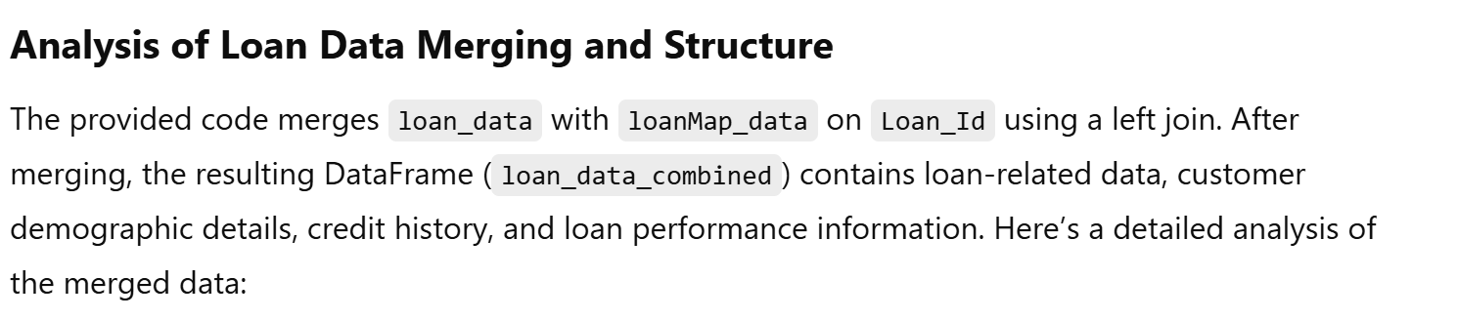
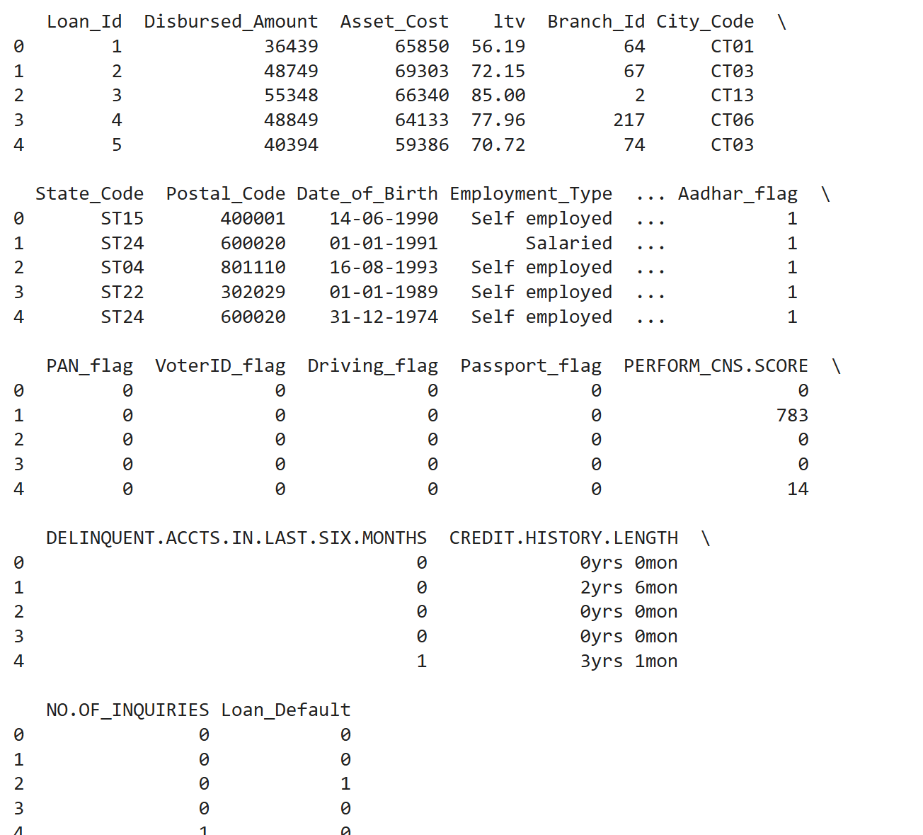
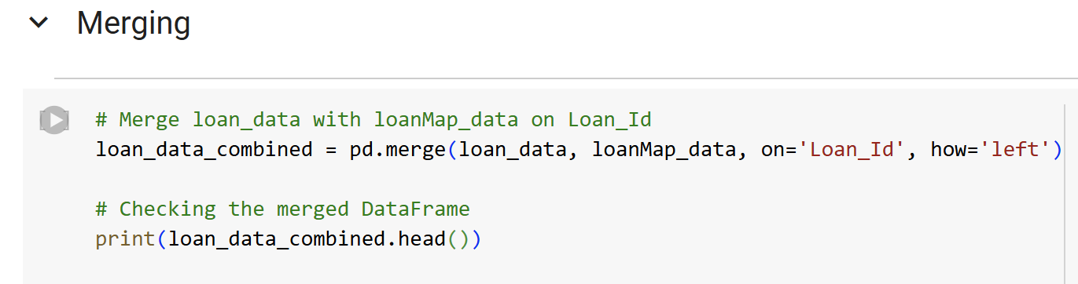
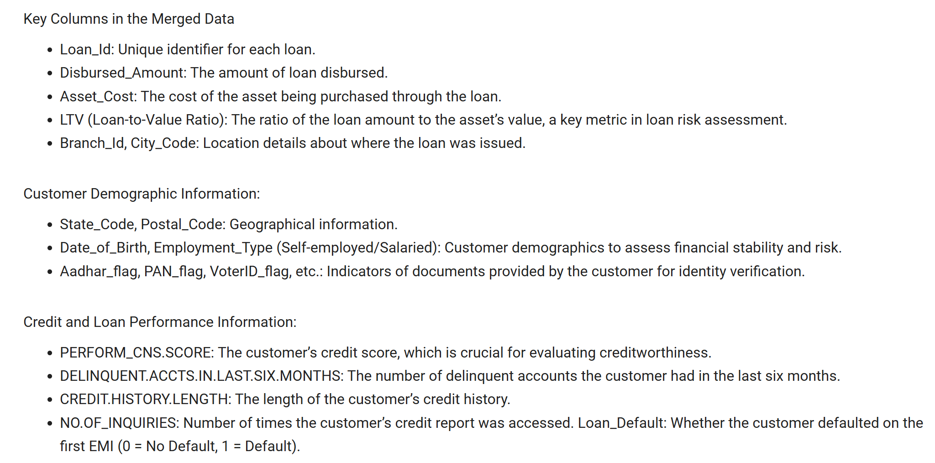

Slide 17
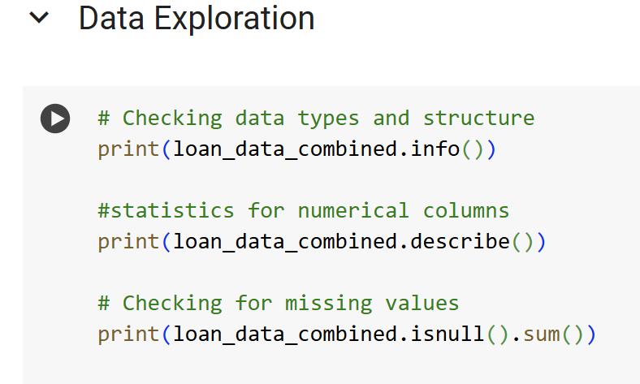
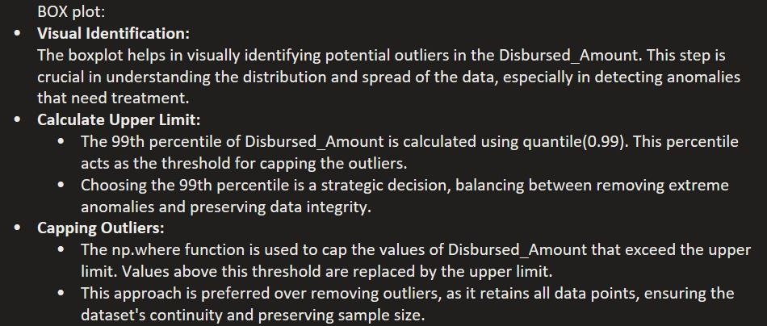
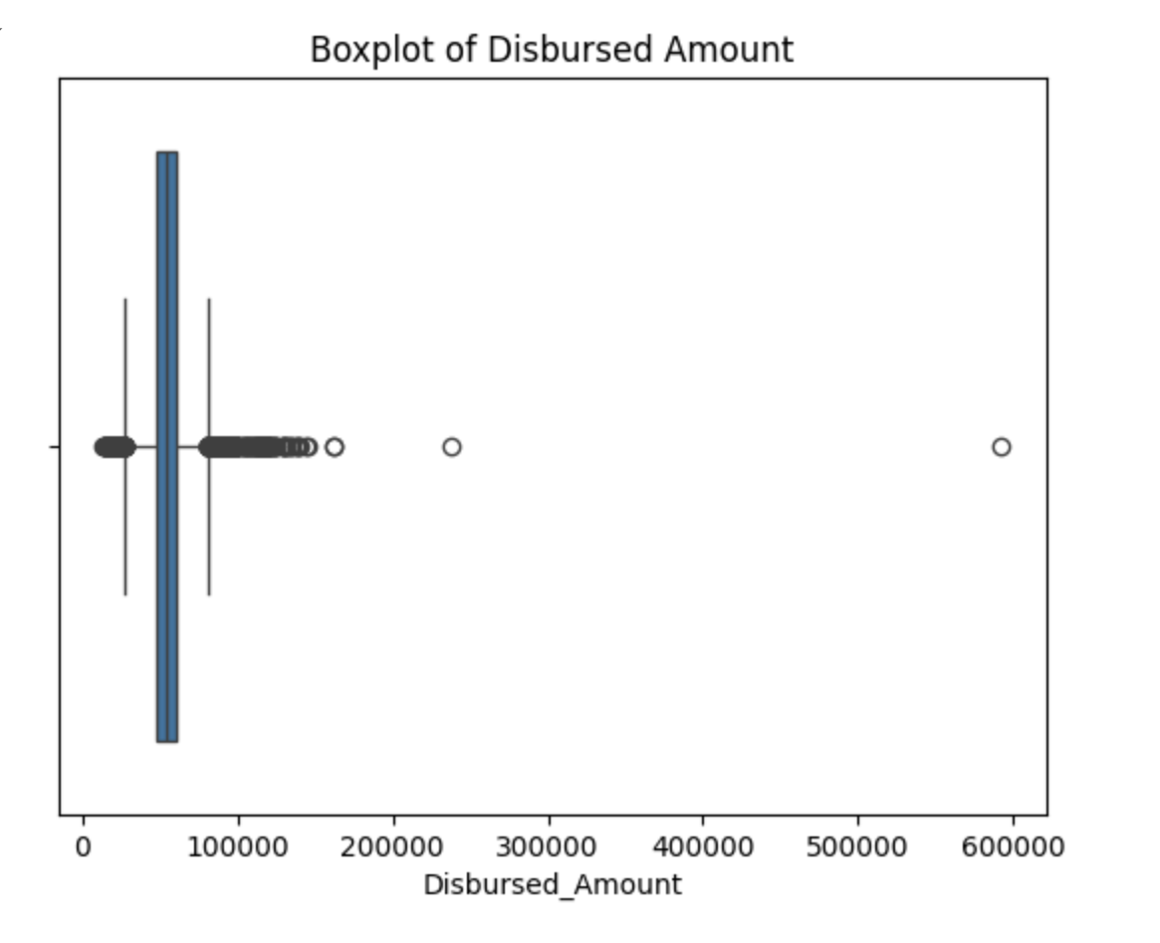
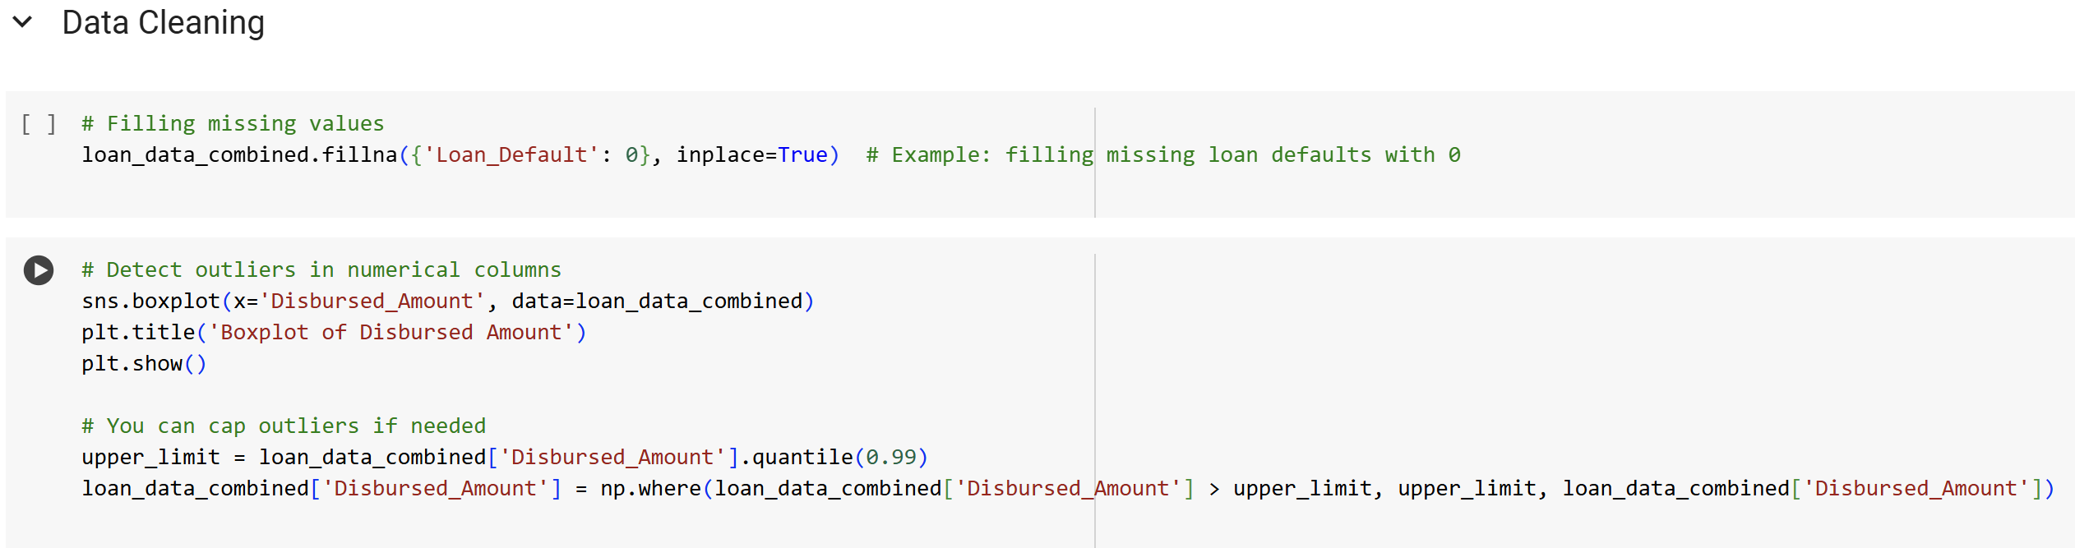

Slide 18
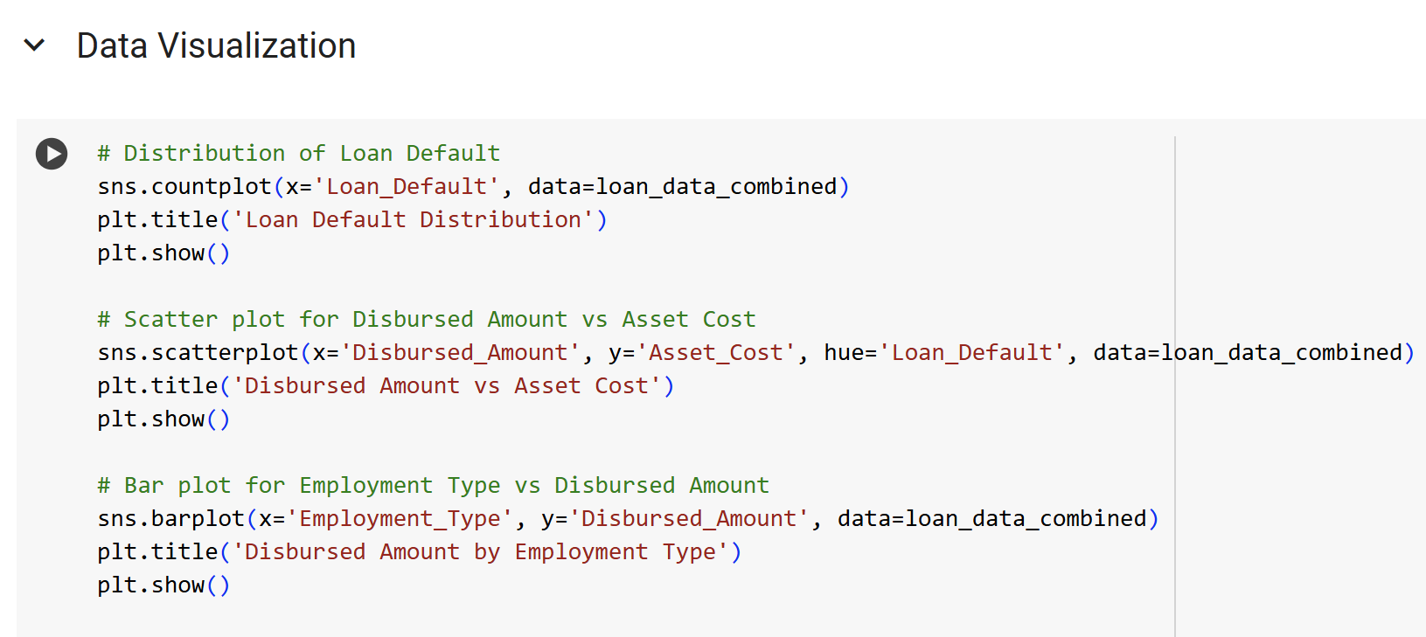
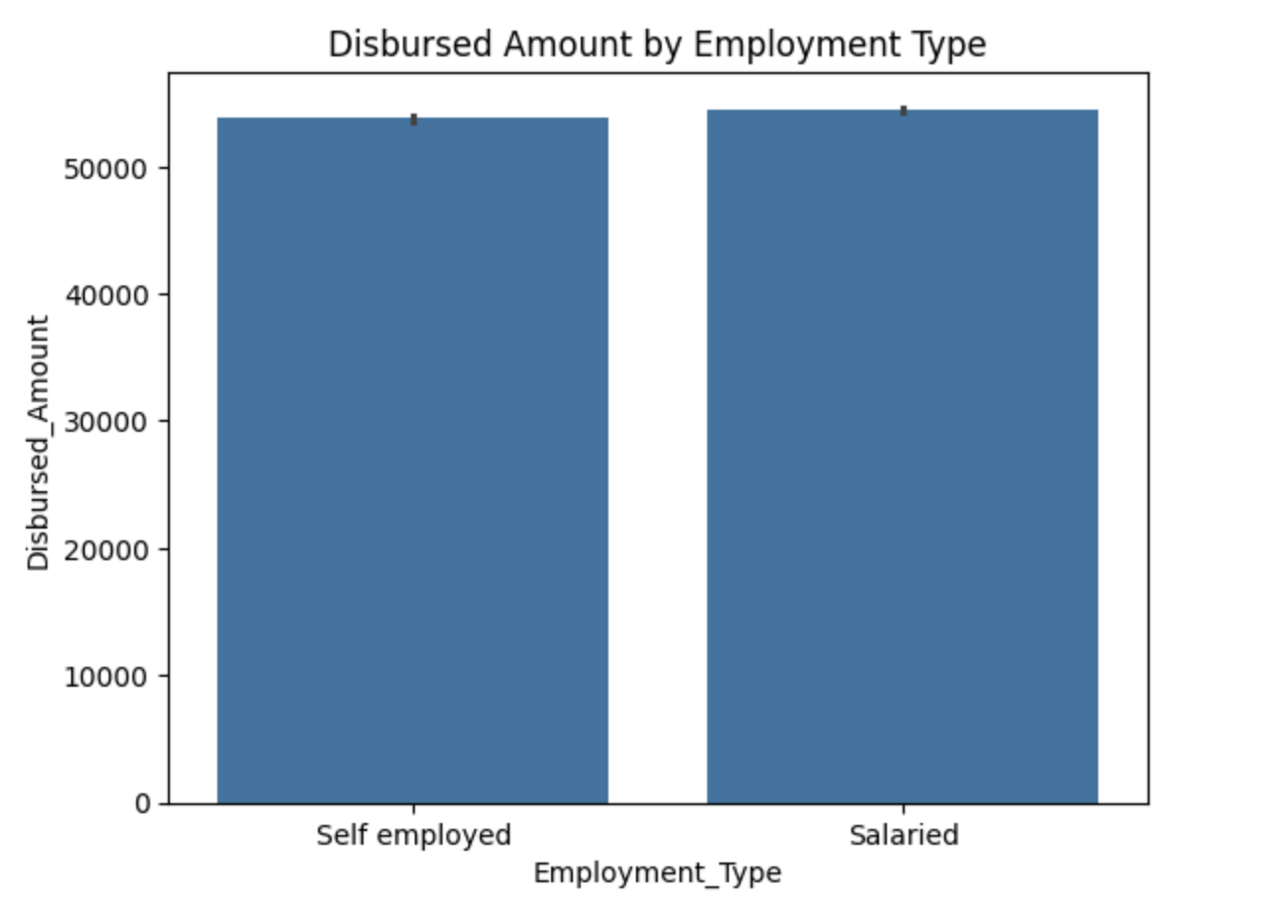
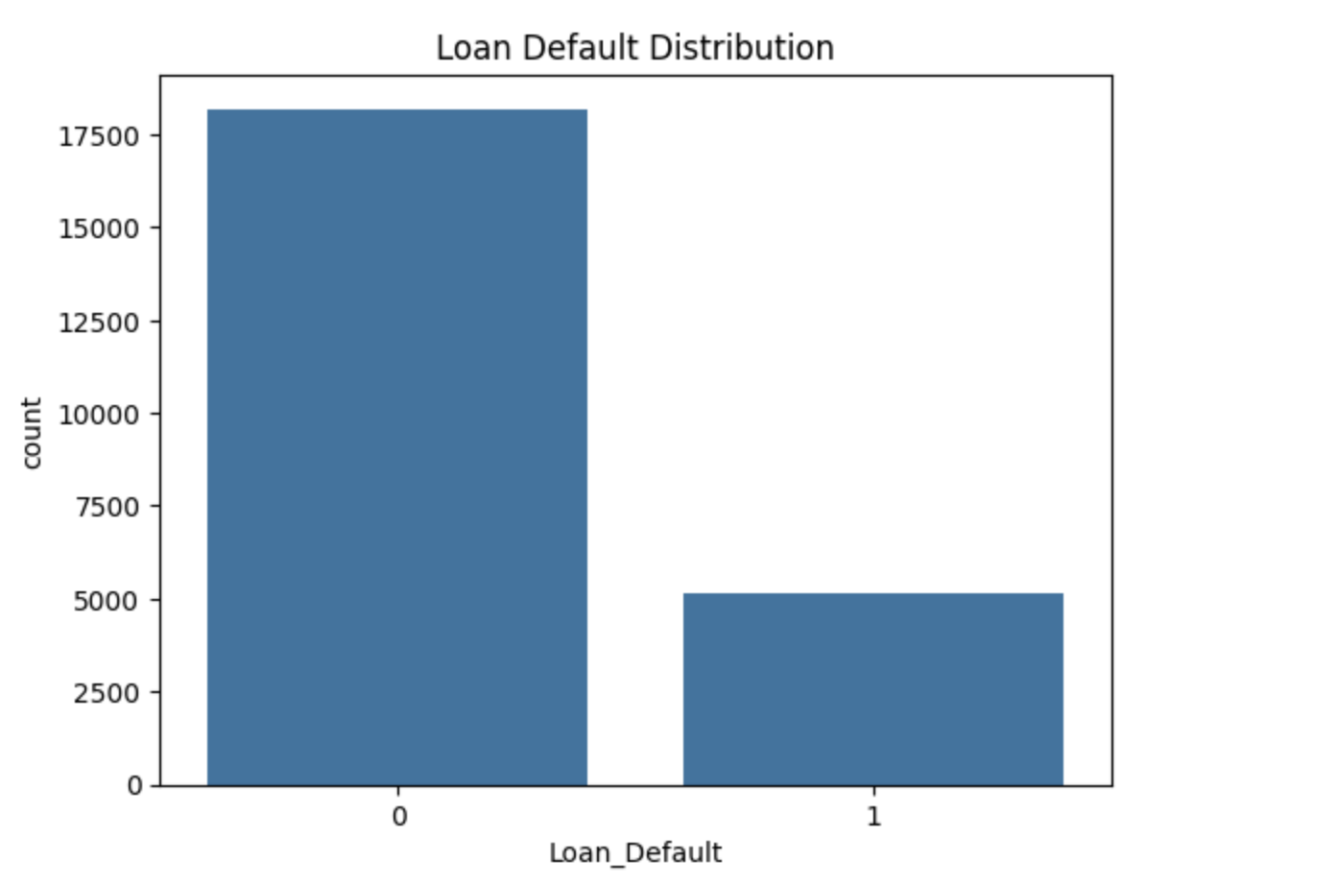
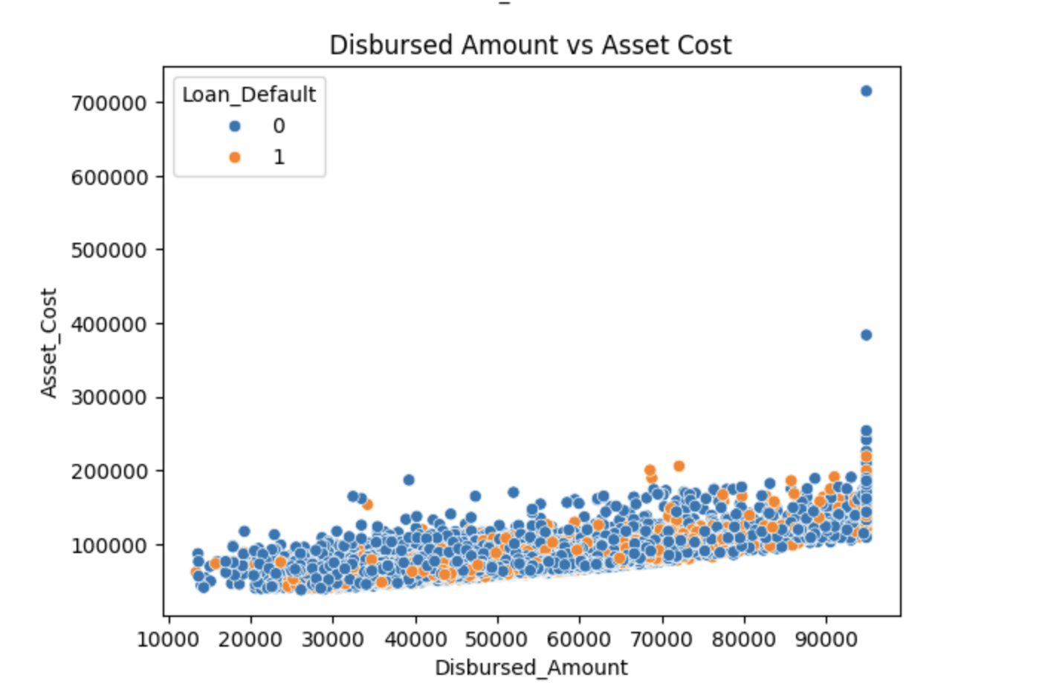
The scatter plot in the image depicts the relationship between "Disbursed Amount" (x-axis) and "Asset Cost" (y-axis) with two distinct classes of "Loan Default" (0 or 1) represented by different colors. Here's a brief inference:
Loan Default Classes:
Blue dots: Represent cases where loans were not defaulted.
Orange dots : Represent cases where loans were defaulted.
Distribution:
Most data points cluster towards lower disbursed amounts (under 40,000) and asset costs (under 300,000), regardless of whether they defaulted or not.
There are outliers with higher disbursed amounts (around 90,000) and higher asset costs, but defaults in these cases seem sparse.
Pattern:
Defaults (orange points) are scattered across the entire range but seem to increase slightly as disbursed amounts increase, particularly when the asset cost is higher.
Loan Default (0): Represents the count of loans that were not defaulted. This count is significantly higher, around 17,500.
Loan Default (1): Represents the count of loans that defaulted. This count is lower, around 7,500.
Inference:
Imbalance in the dataset: There is a clear imbalance between the two categories, with non-defaulted loans outnumbering defaulted ones by a large margin. This indicates that the majority of loans were successfully paid back without default, which might affect model training if not handled properly (e.g., by resampling or using techniques to address class imbalance)

Slide 19
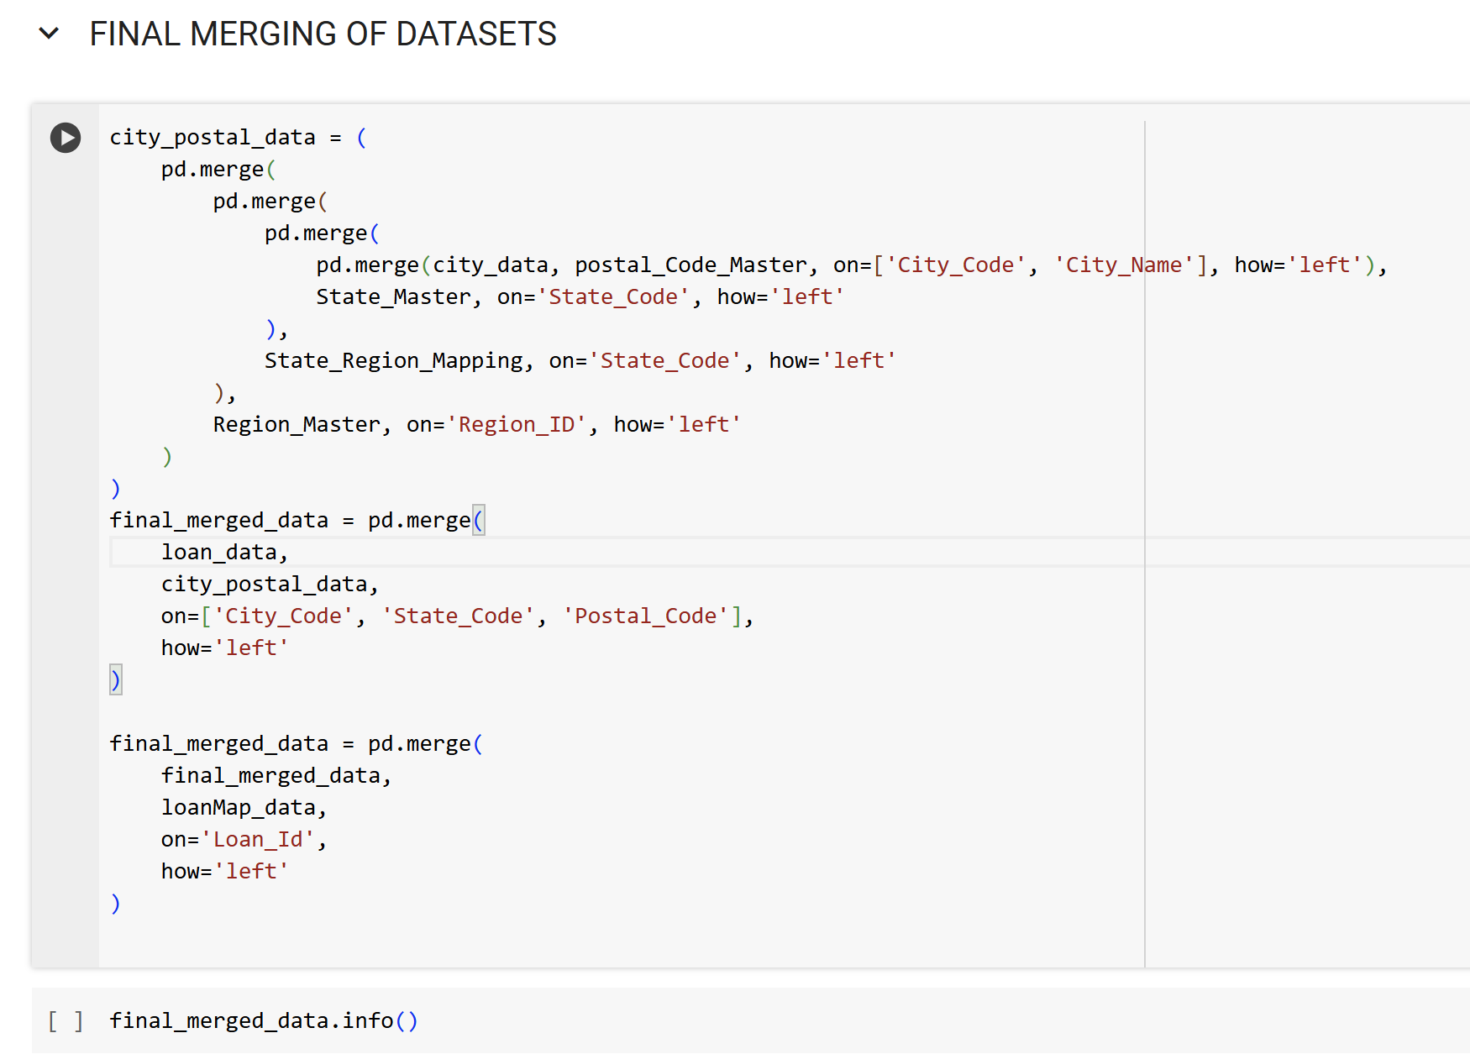
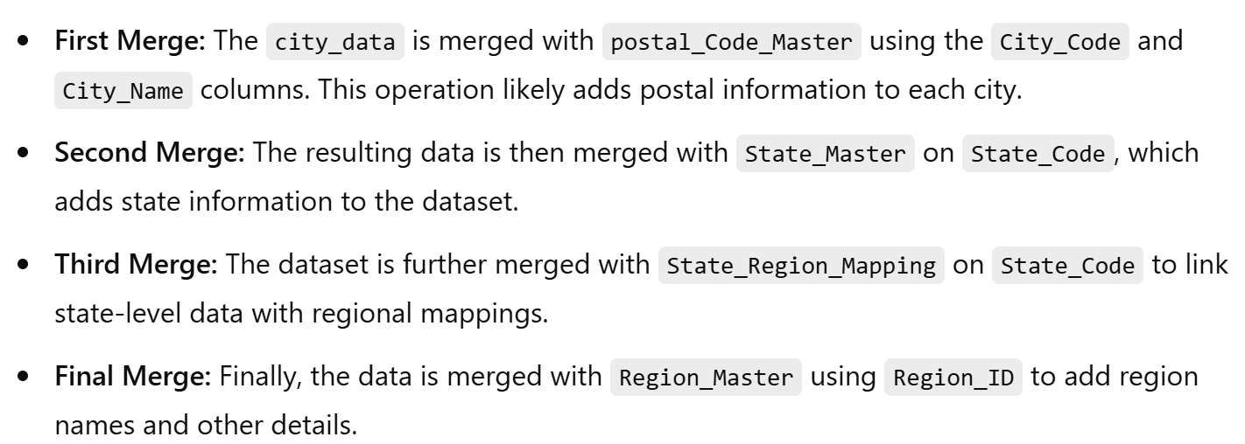
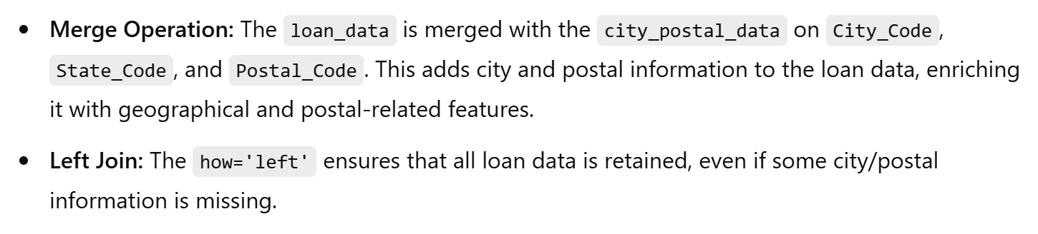
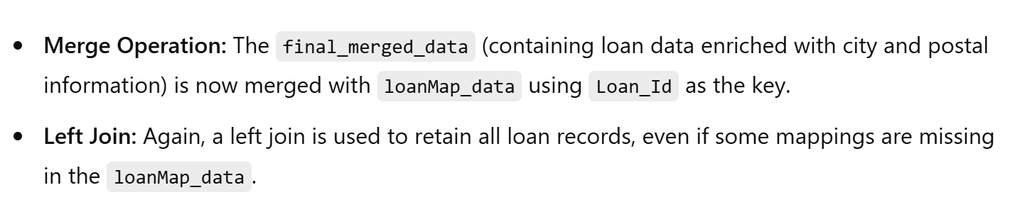

Slide 20
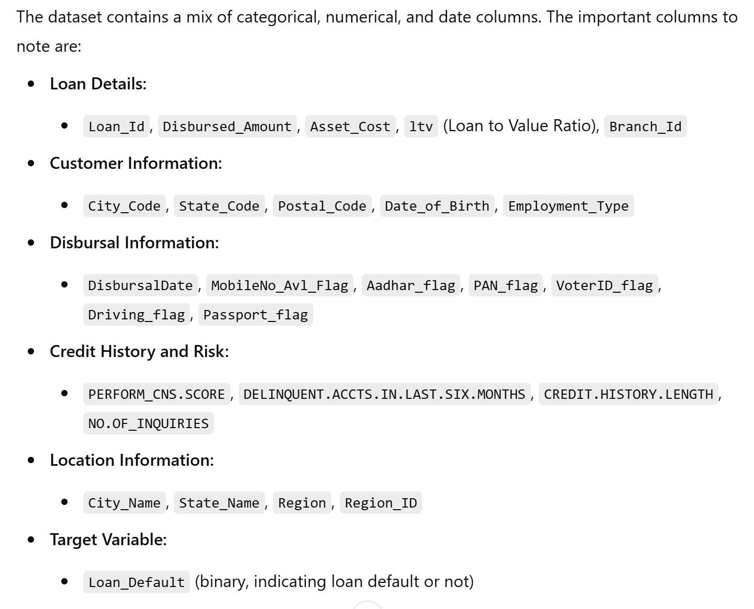
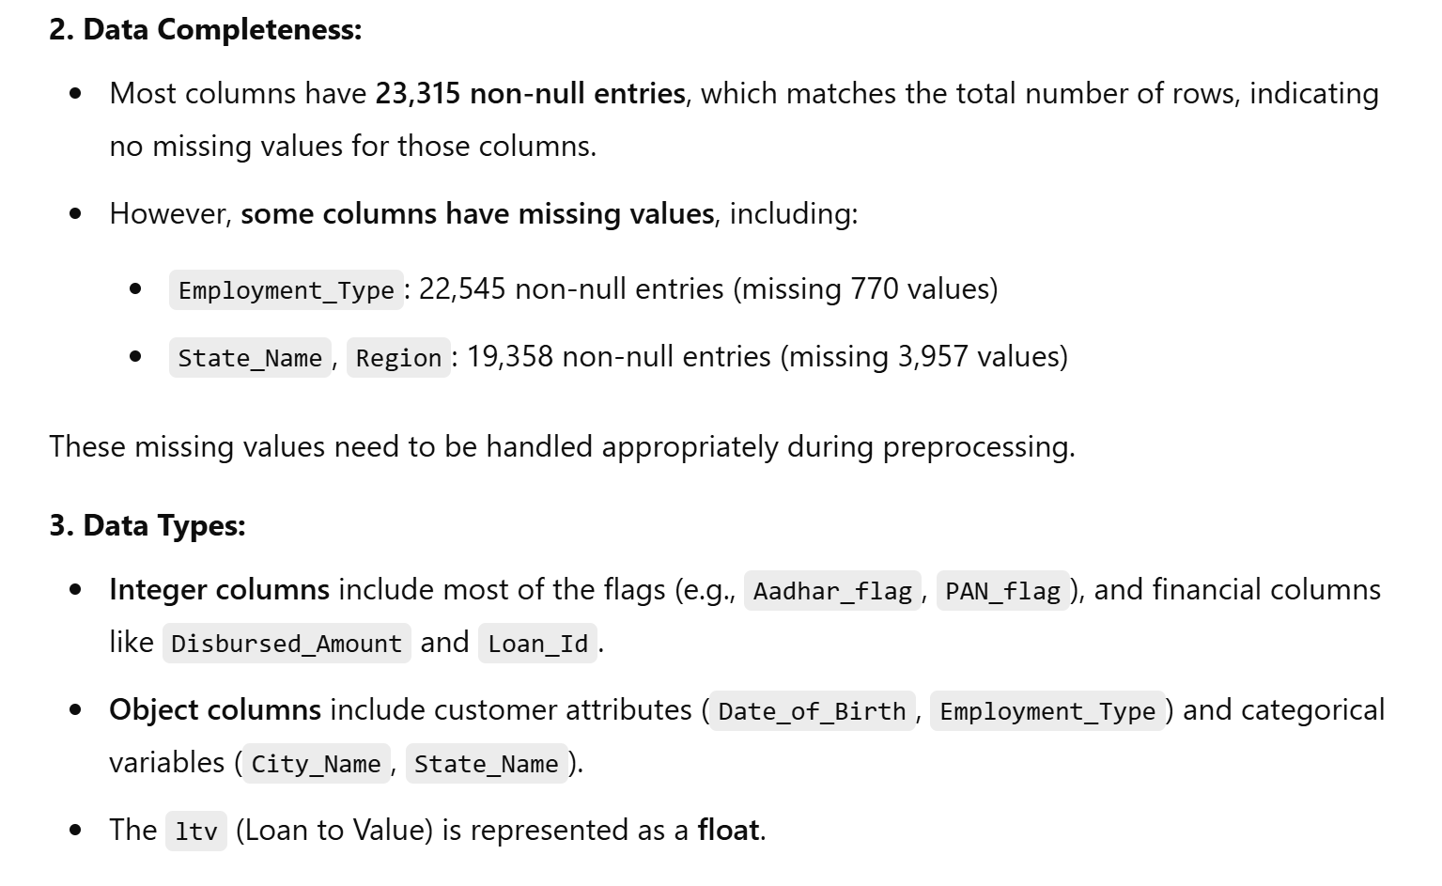

Slide 21
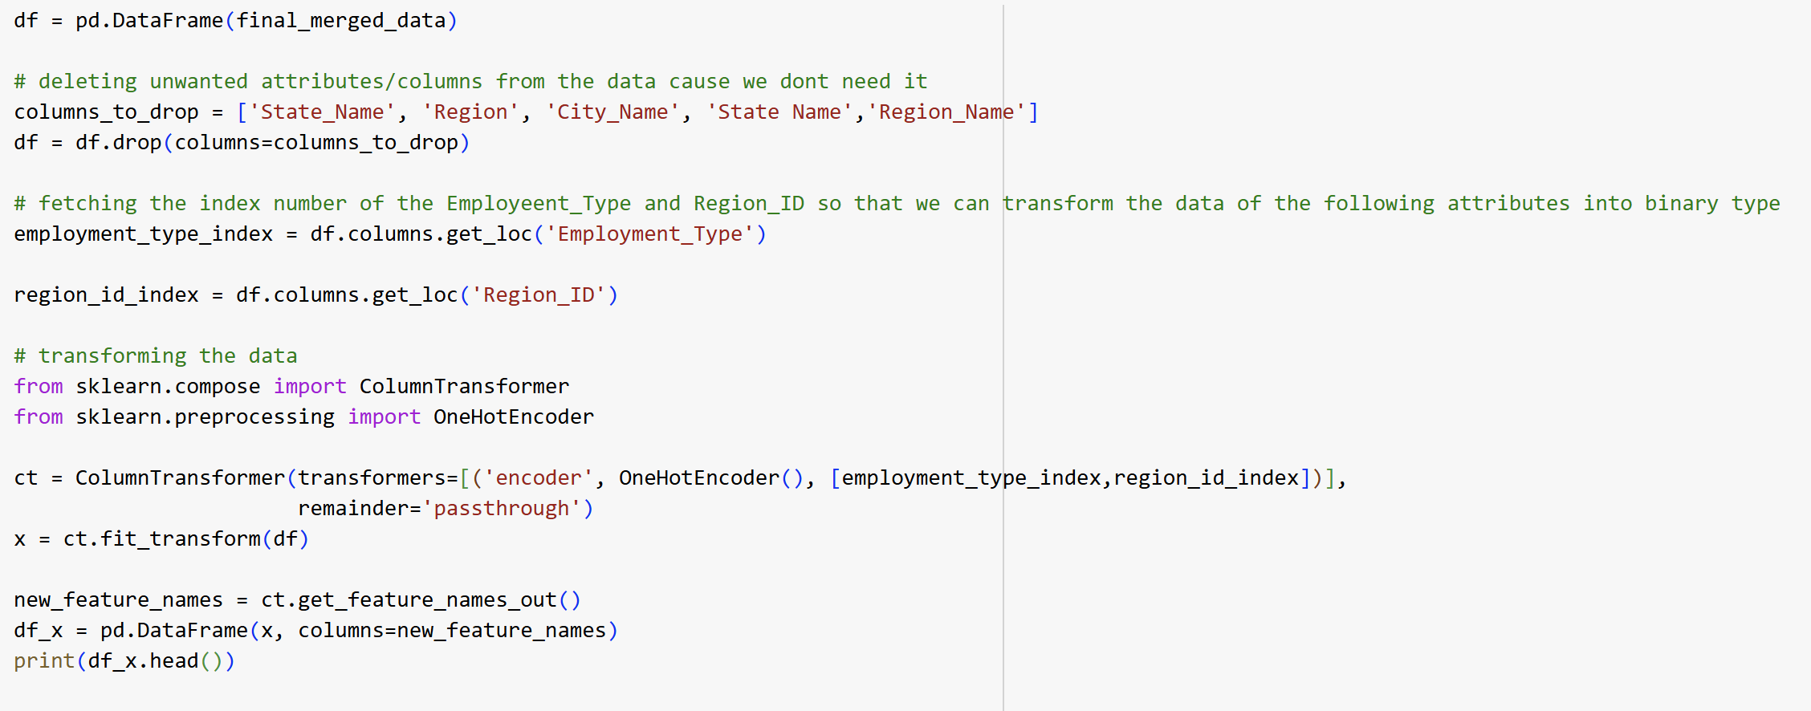
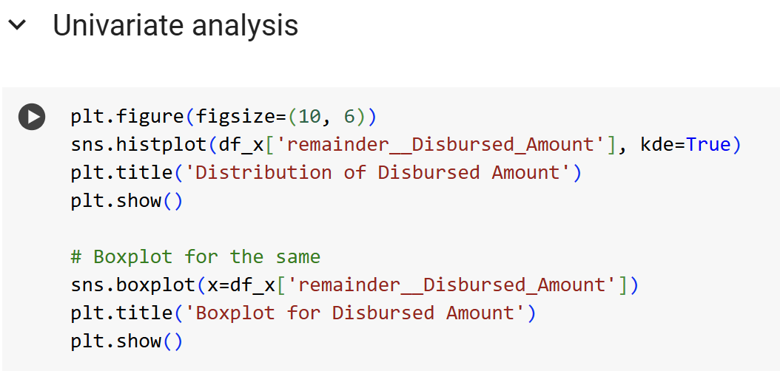
Analysis of Data Transformation

Slide 22
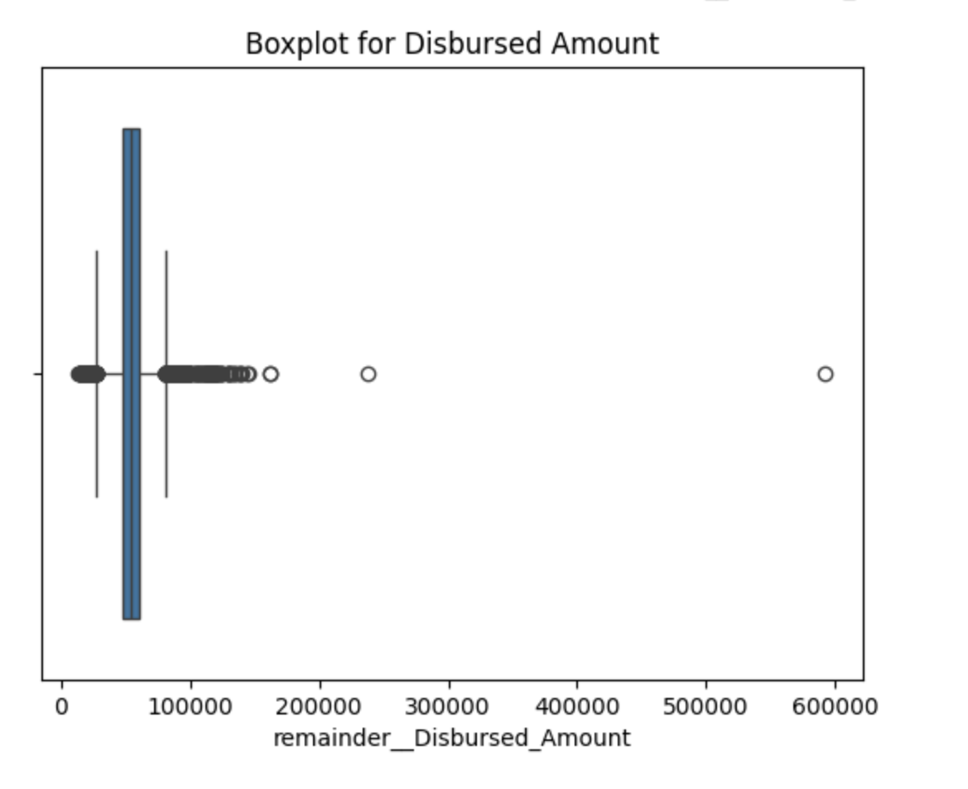
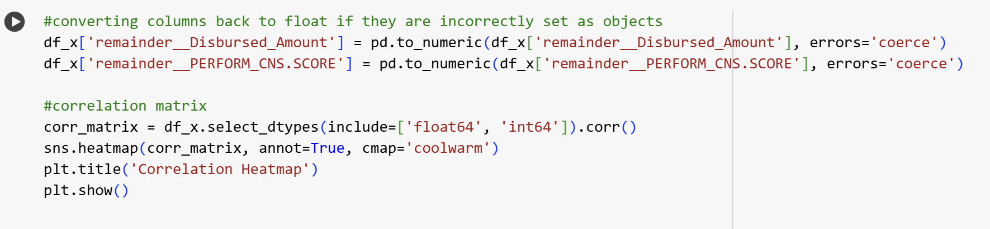
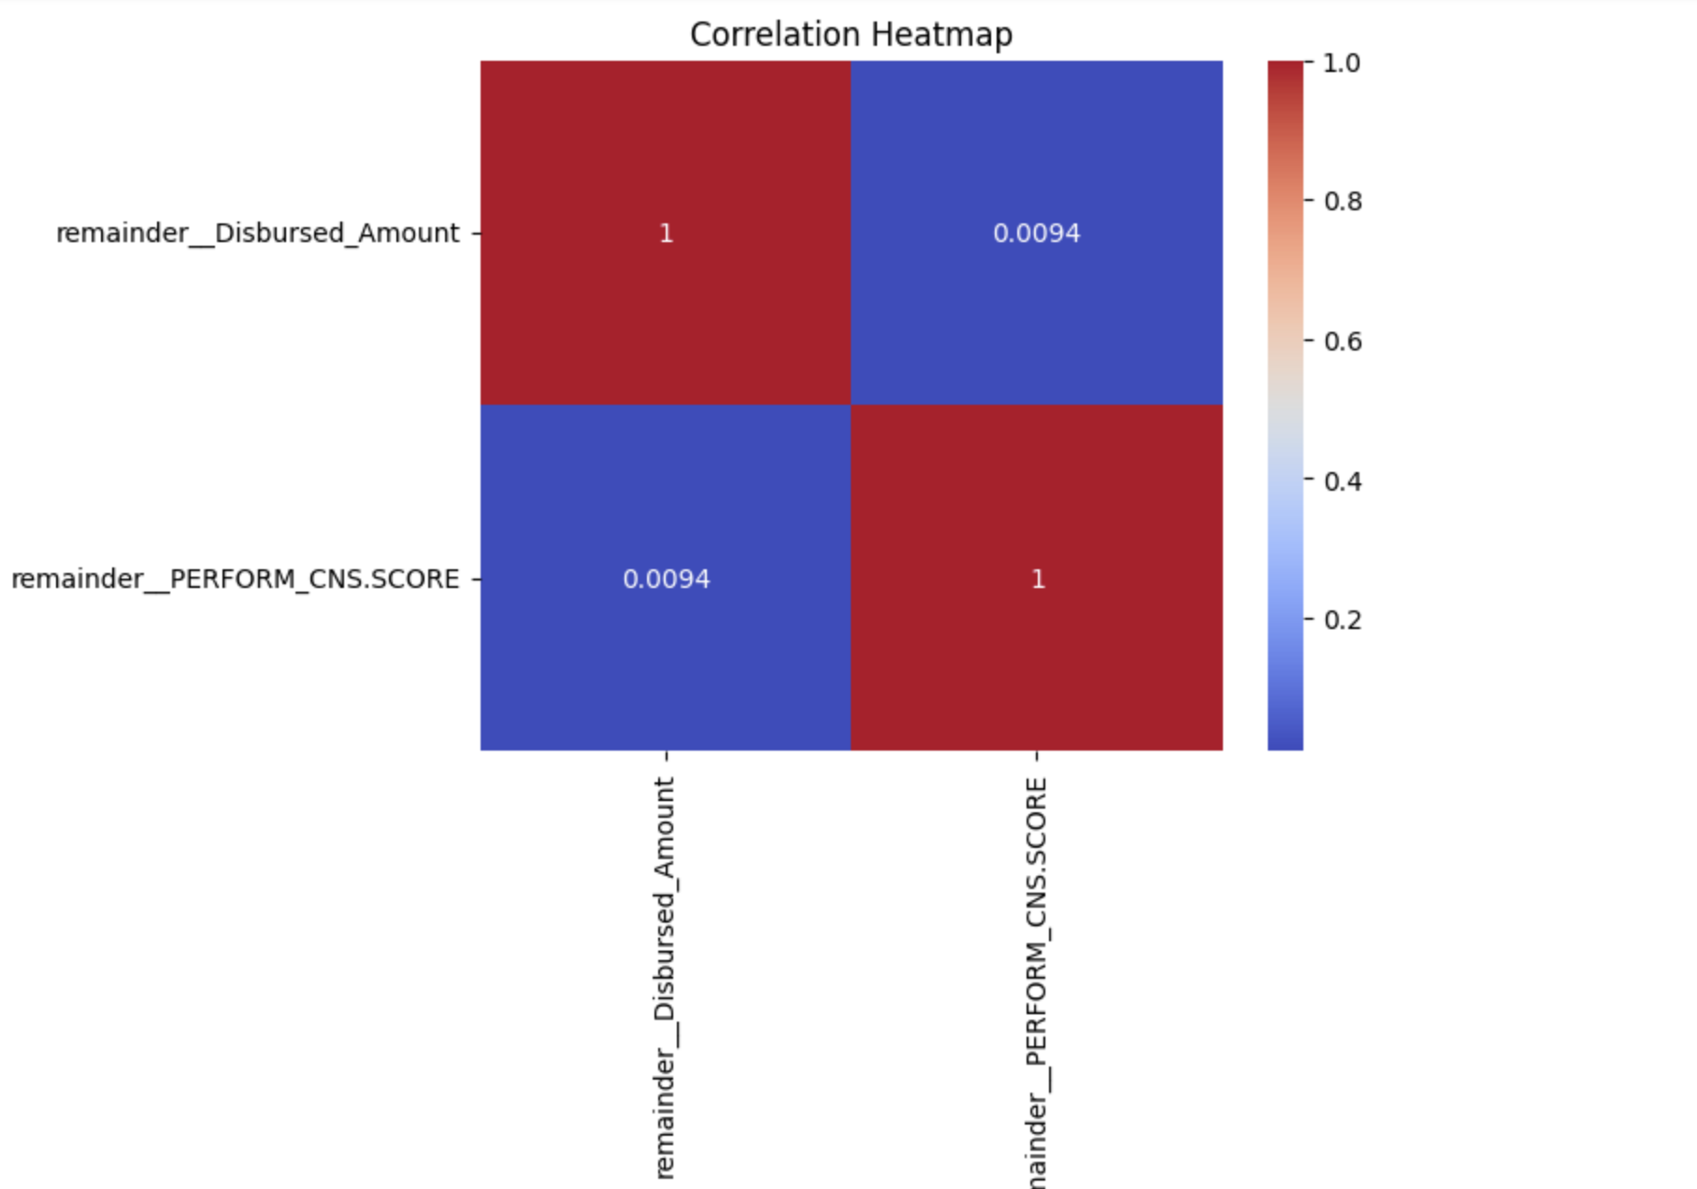
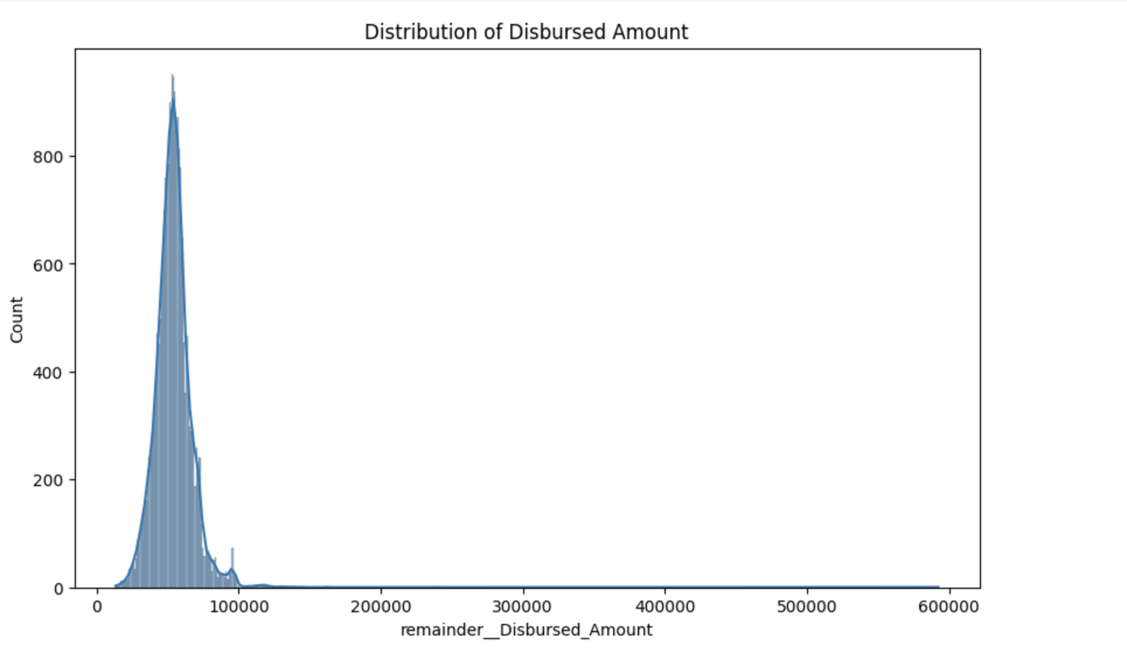

Slide 23
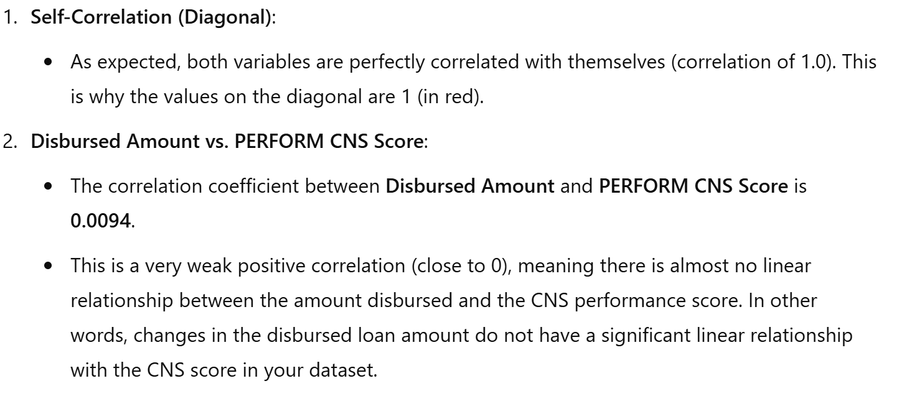

Slide 24
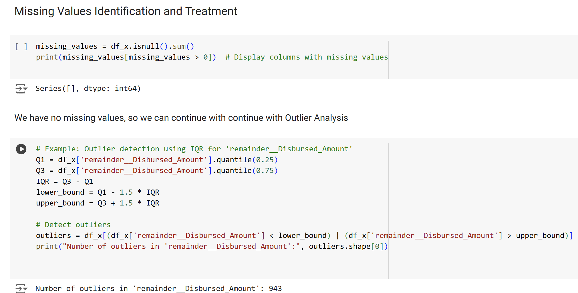

Slide 25
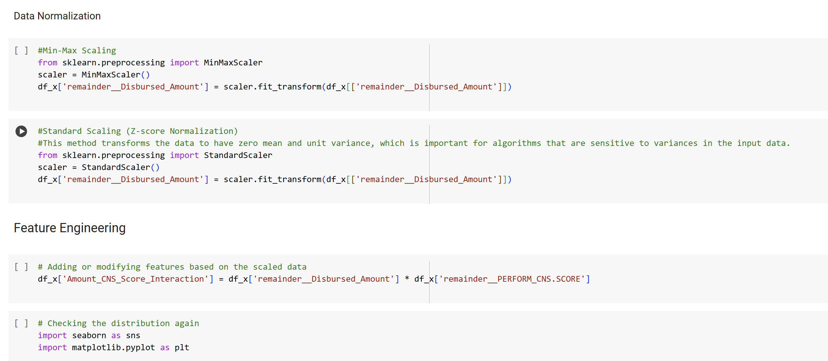

Slide 26
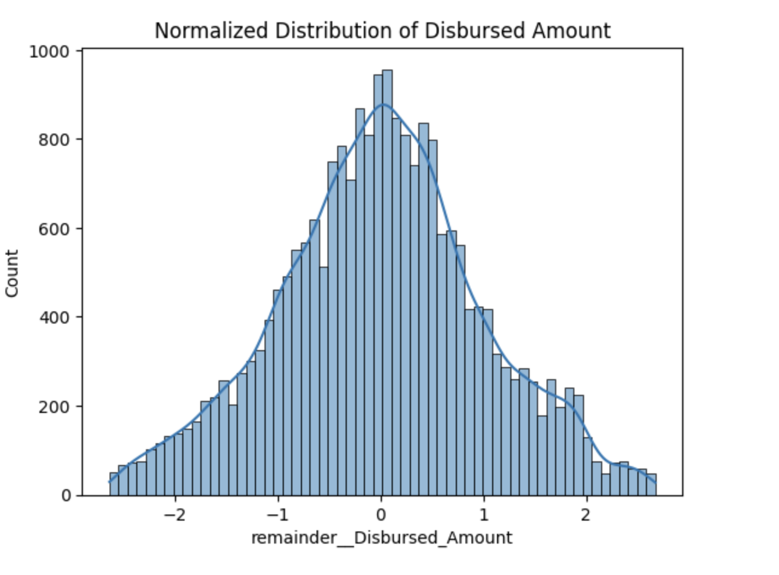
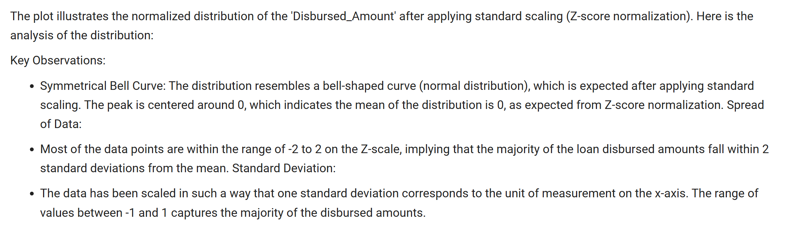

Slide 27
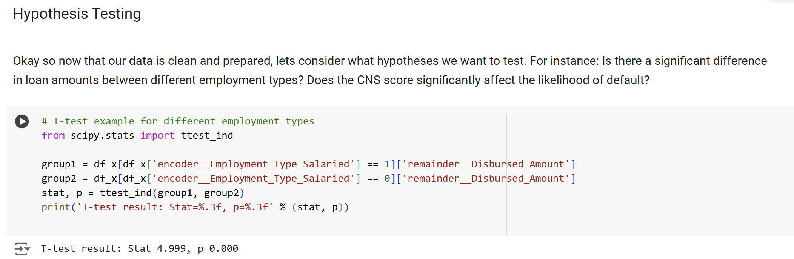
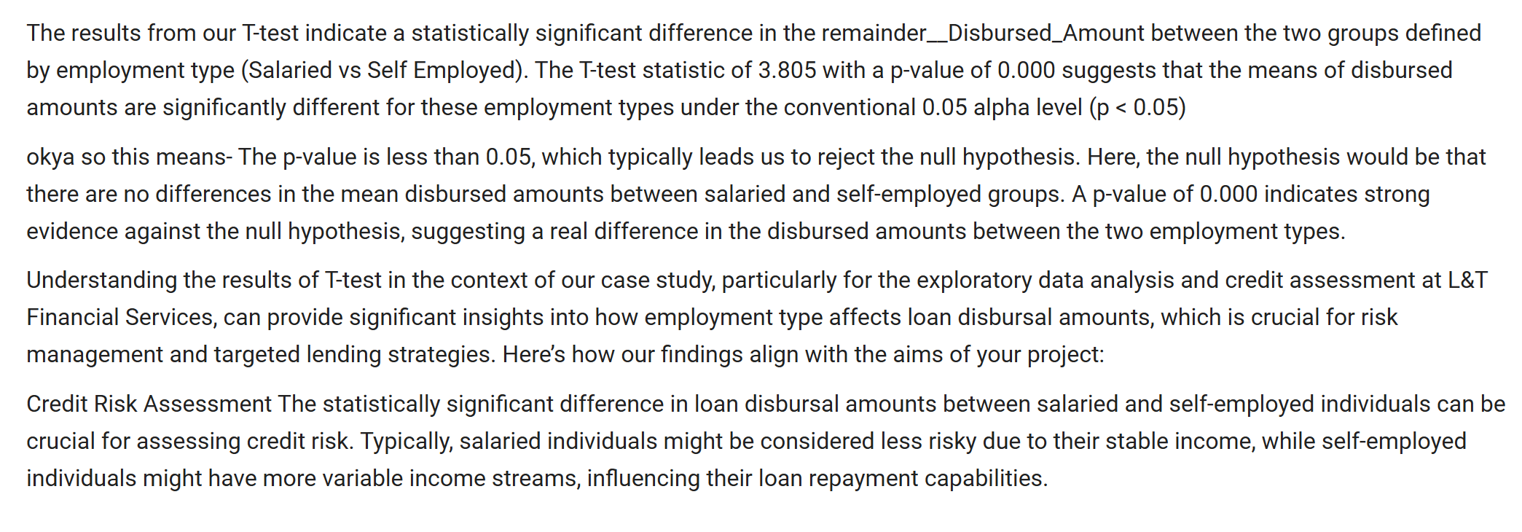

Slide 28
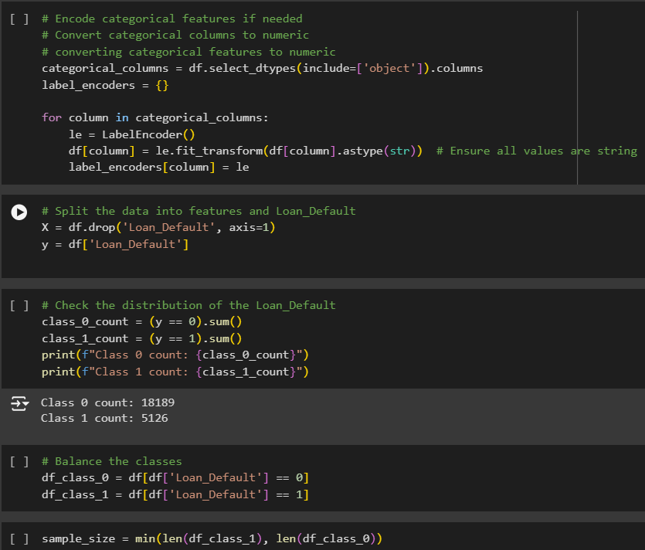
Model Training
We have used 3 ML algorithm:
Logistic Regression
Random Forest
Decision Tree
Here in this slide we are prepping the data for the model training

Slide 29
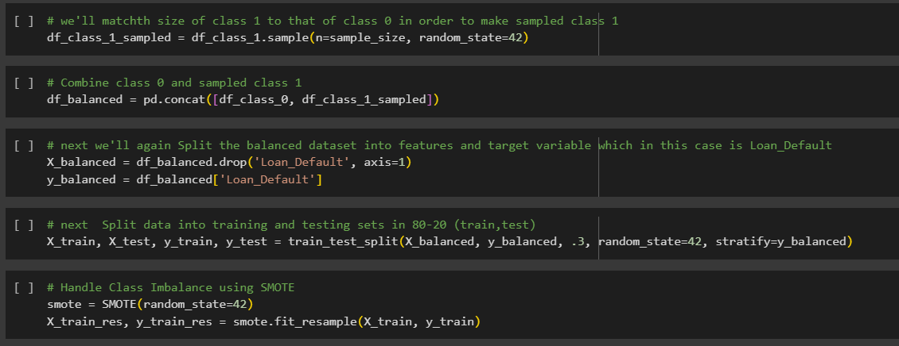

Slide 30
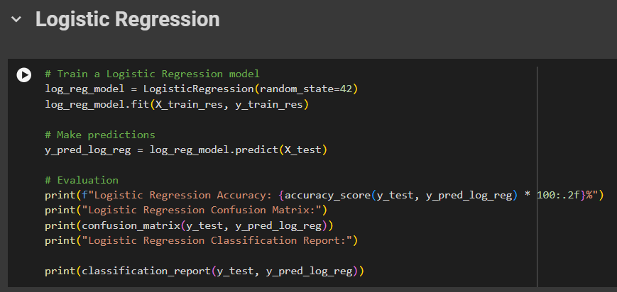
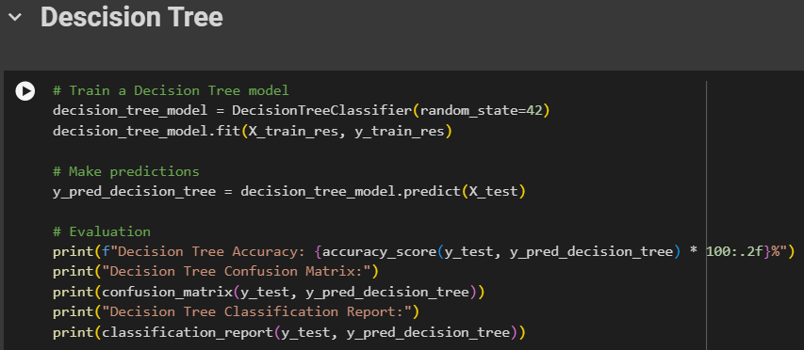

Here, we are training our three chosen Models

Slide 31



From the Classification report we can see that Random forest is out performing all the ML algorithms with a precision of 80.5%
We further visualized the report using Line graph and confusion Matrix

Slide 32

Looking at the data and graph we have decide to use Random Forest as our chosen model due it’s better performance Rate

Slide 33

We further Tuned our model with Hyperparameter using Random Search

Slide 34

We further check the Feature importance
From the graph we obtained we can understand that PERFORM_CNS.SCORE has the highest importance followed by Branch_Id and so on..

Slide 35


From this graph we can infer that:
Self-employed have more loan Defaults compared to Salaried People
ST-12(State code) has more of Self Employed Defaulters and
ST-07 has the most Salaried Defaulters

Slide 36


Here we created a comparison graph for the flags:
What we realised from this graph was that:
Most of the loan Defaulters do not have the data :
Mobile no
Aadhar
PAN
Voter Id
Driving ID
Passport

Slide 37
Taking things further we also made a flask application to deploy our Model the preview we have on the next slide

Slide 38


Slide 39


Slide 40


Slide 41
Conclusion:
PERFORM_CNS.SCORE has the highest importance emerges as a significant predictor, with lower scores indicating higher default risk .
Self-employed have more loan Defaults compared to Salaried People
Other factors such as loan amount, asset cost, LTV, employment type, and the presence of certain flags also contribute to the likelihood of default.
Largest number of loan is taken from Karnataka
And largest number of defaulters are also from Karnataka

Slide 42

Accuracy of imbalanced data

